Slide 1

Time Series Analysis
Jacob Polomsky

Slide 2

To What extent can the Closing Price of SPY be predicted?

Slide 3
Null Hyothesis
We measure the extent to which we can predict SPY to see if we can predict the closing price of SPY with 90% accuracy.

Slide 4

ARIMA and SARIMA
We Need to Find
p
d
q
Possibly seasonality
P
D
Q

Slide 5
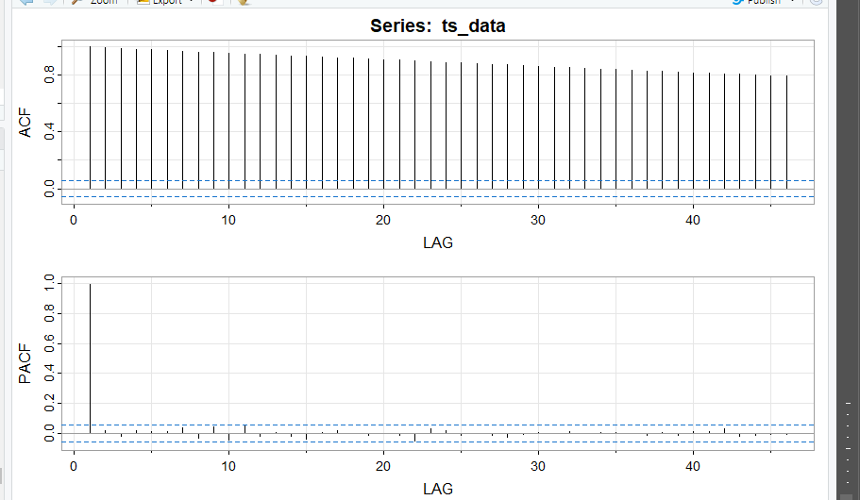

Slide 6
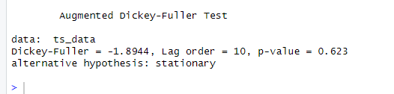

Slide 7
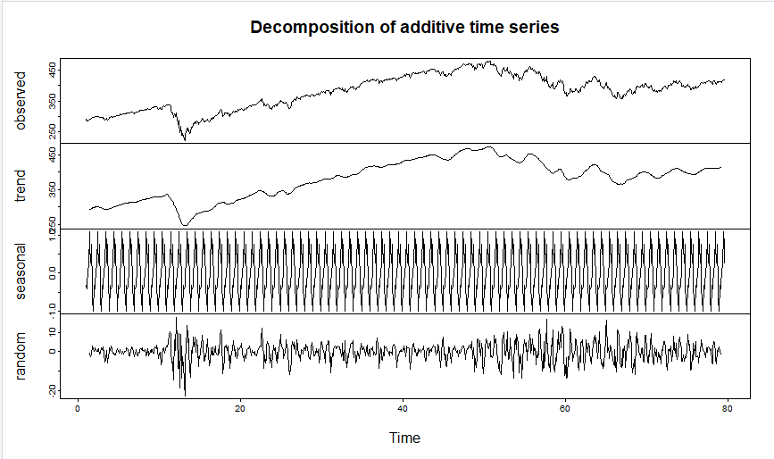

Slide 8
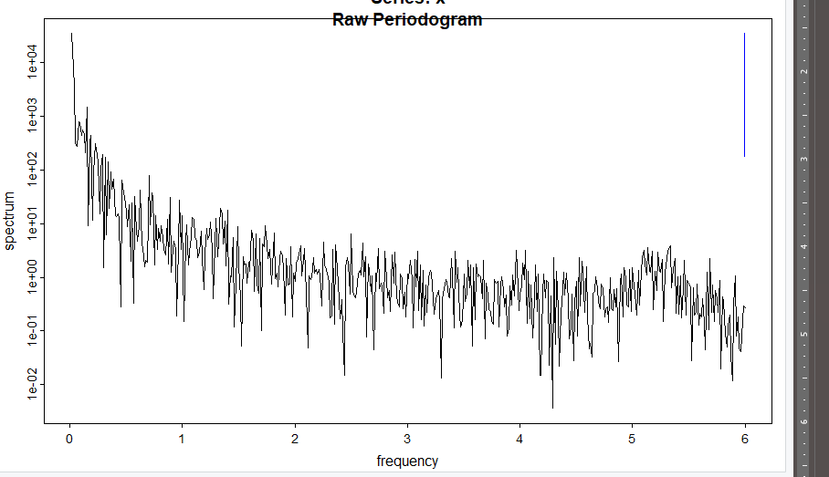

Slide 9
With out Test
p – 1
d – 0
q – 0
P- 0
D- 1
Q- 0

Slide 10

Model 1

Slide 11
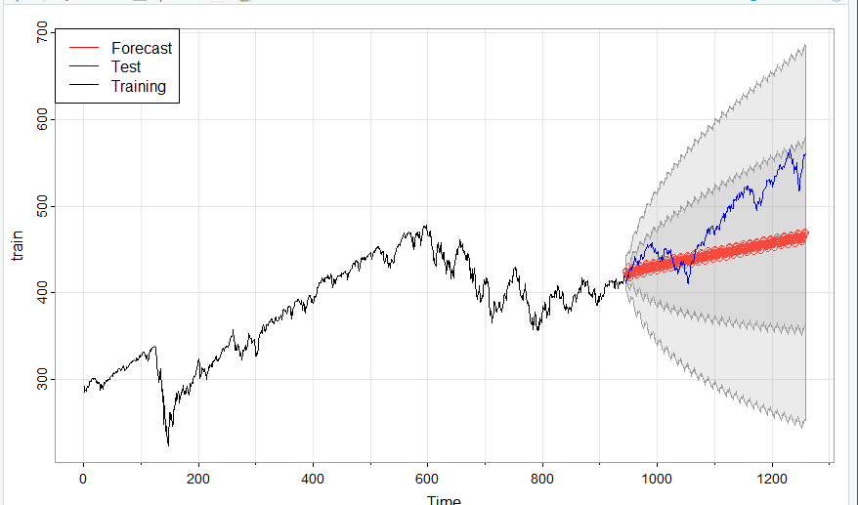

Slide 12
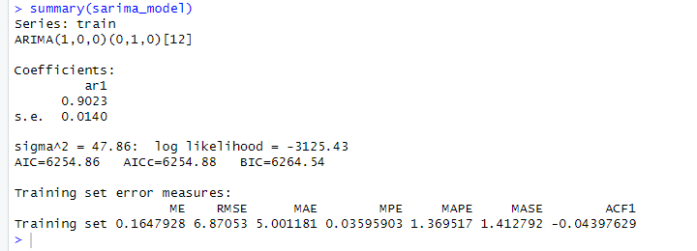

Slide 13
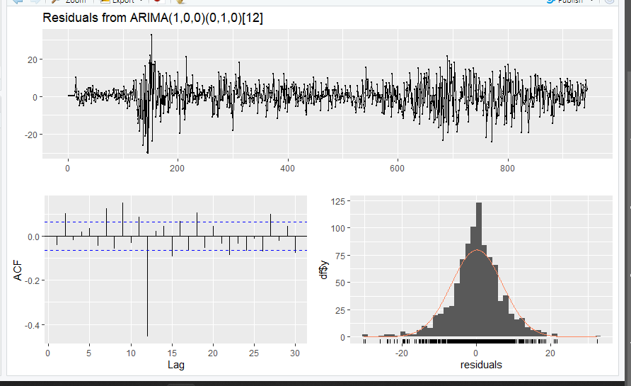

Slide 14

Model 2

Slide 15
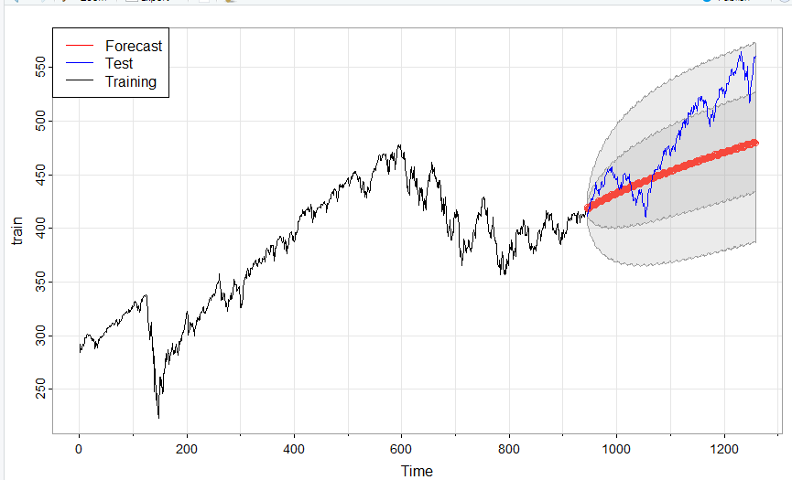

Slide 16
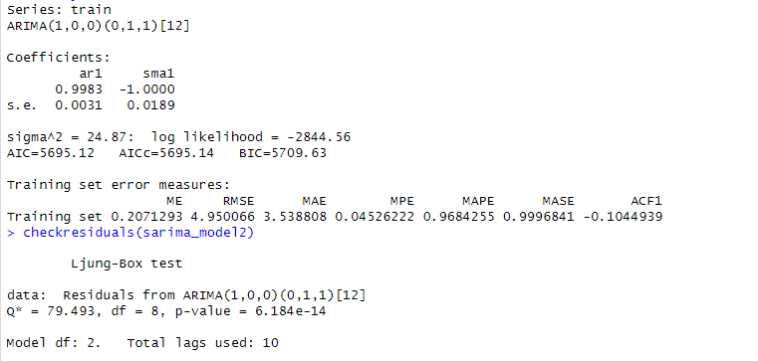

Slide 17
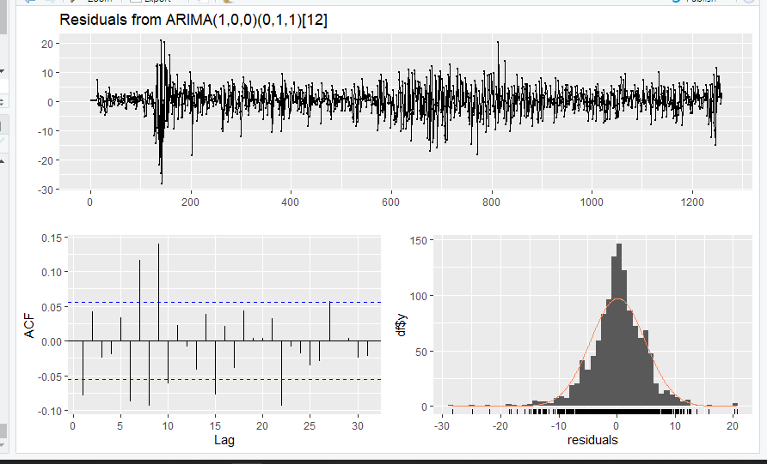

Slide 18
Model 2
Model 1

Slide 19
Model 2
Model 1

Slide 21
